Slide 1
PROJECT MOONBANK
GCP ACCELERATION PROGRAM – GROUP 2
FORREST CAI, MAX LUO, MICHAEL SUN, VICTOR LU, VINCENT ZENG

Slide 2
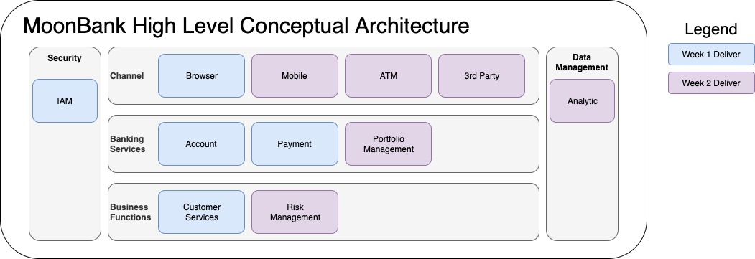
BACKGROUND & CONCEPTUAL ARCHITECTURE
MoonBank bank is brand new with global footprint in rapid growth
All services are on Cloud, no legacy, no branches, etc.
Notes:
Technical Requirements
Low Latency
Dynamically scale up or down based on customer usage
Connect to a transaction database service to manage customer information
Store banking activity in a time-series database service for future analysis
Ensure that data is not lost due to processing backlogs

Slide 3
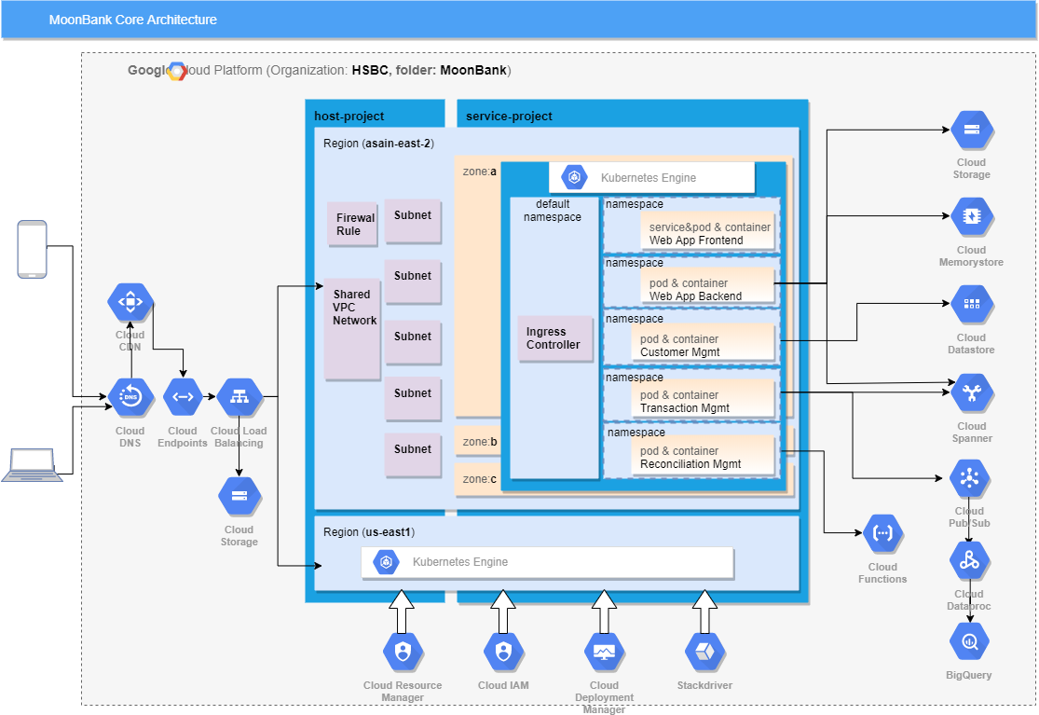
APPLICATION ARCHITECTURE

Slide 4
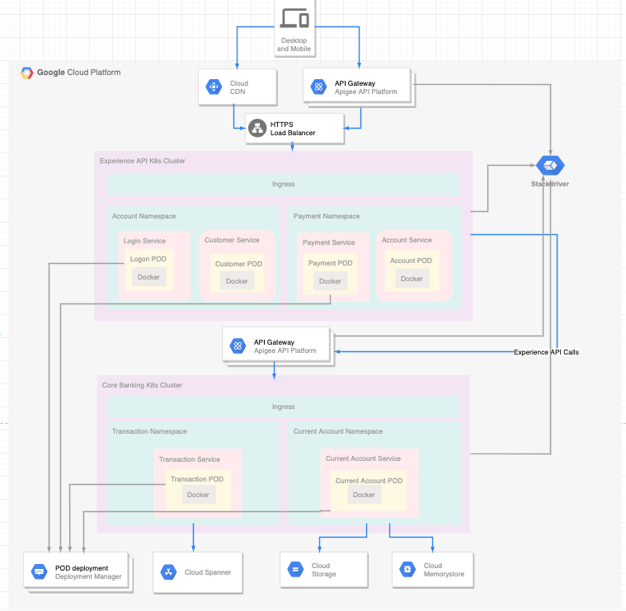
WEB APP INFRASTRUCTURE
Decision Points:
GKE cluster to host the core web application. Cloud endpoint to project the web APIs and use the CDN to host the static web content.
Pros:
CDN has introduced to serve the global customer with low latency solution to host the static web content.
API Gateway can protected the centrolize APIs for the WEB application.
GKE is designed to host the core web application. It’s fully managed, scalable container basic infrastructure.
Use Cloud BigTable to store the user activity which is the time-series data.
Cloud Storage to store the client data, such image and client files.
Cloud Spanner to store the payment and customer transaction data.
StackDriver to provide the centralized logging, monitoring, error reporting to the GKE cluster.

Slide 5
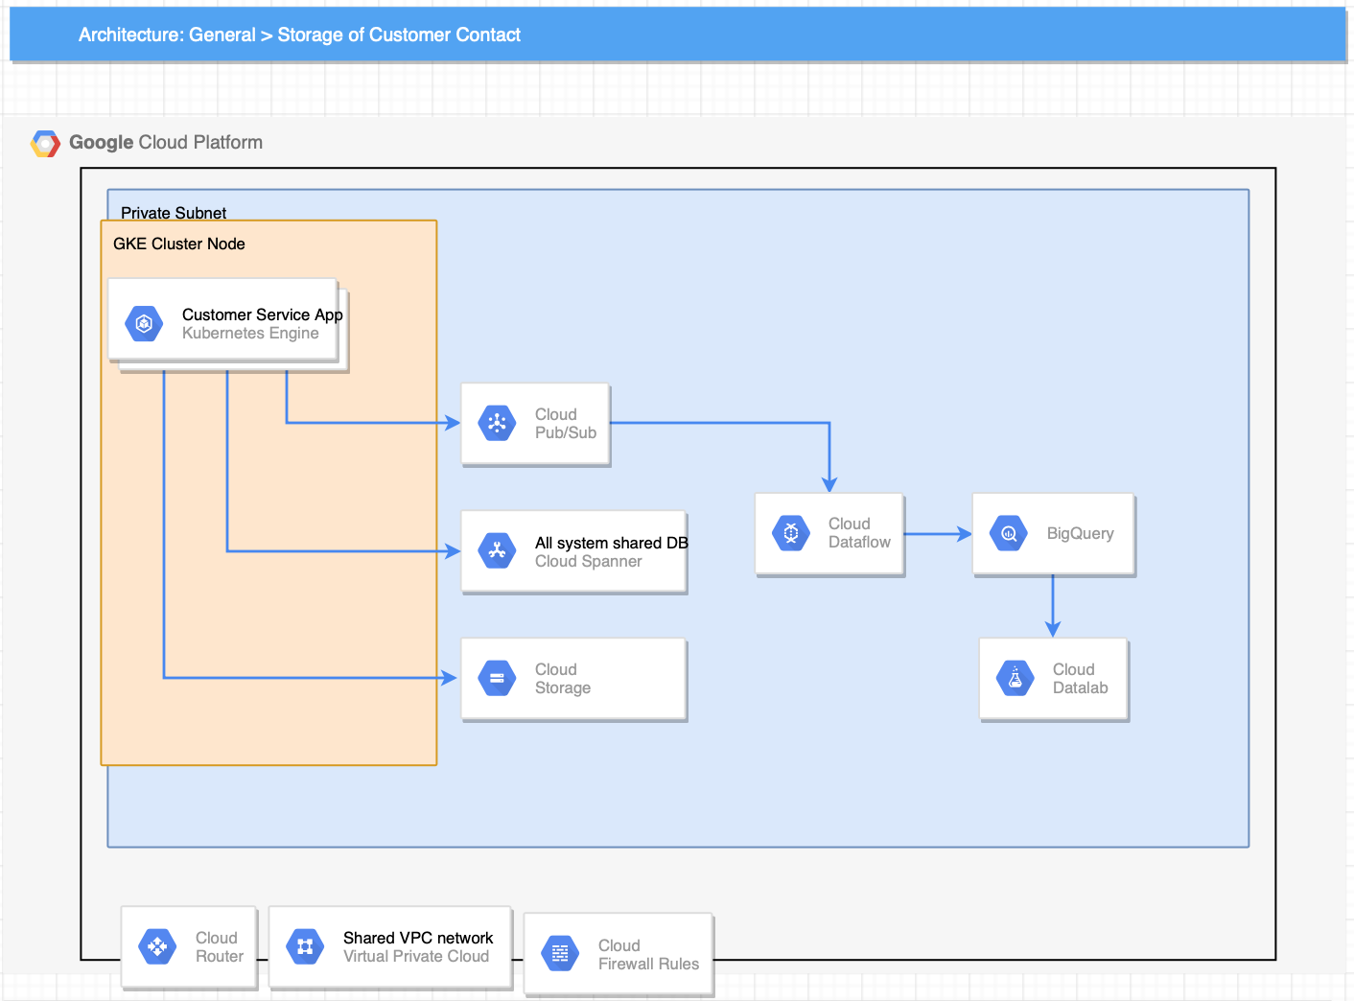
STORAGE INFRASTRUCTURE – CUSTOMER CONTACT
Decision Point:
Customer Contact is private customer information, which might include
1.Phone Number
2.Email Account
3.Home Address
4.Emergency Contact
All of them are text/number and could be used regional Database to store them
Here use Cloud Spanner as moon bank has global footprint
PROs:
Highly Scalable,Available and Strong Consistency, globally distributed without compromising latency.
Cons:
You can use standard SQL to read data from Cloud Spanner, but for write operations you have to use their RPC API. It increases the complexity of Sql operation.

Slide 6
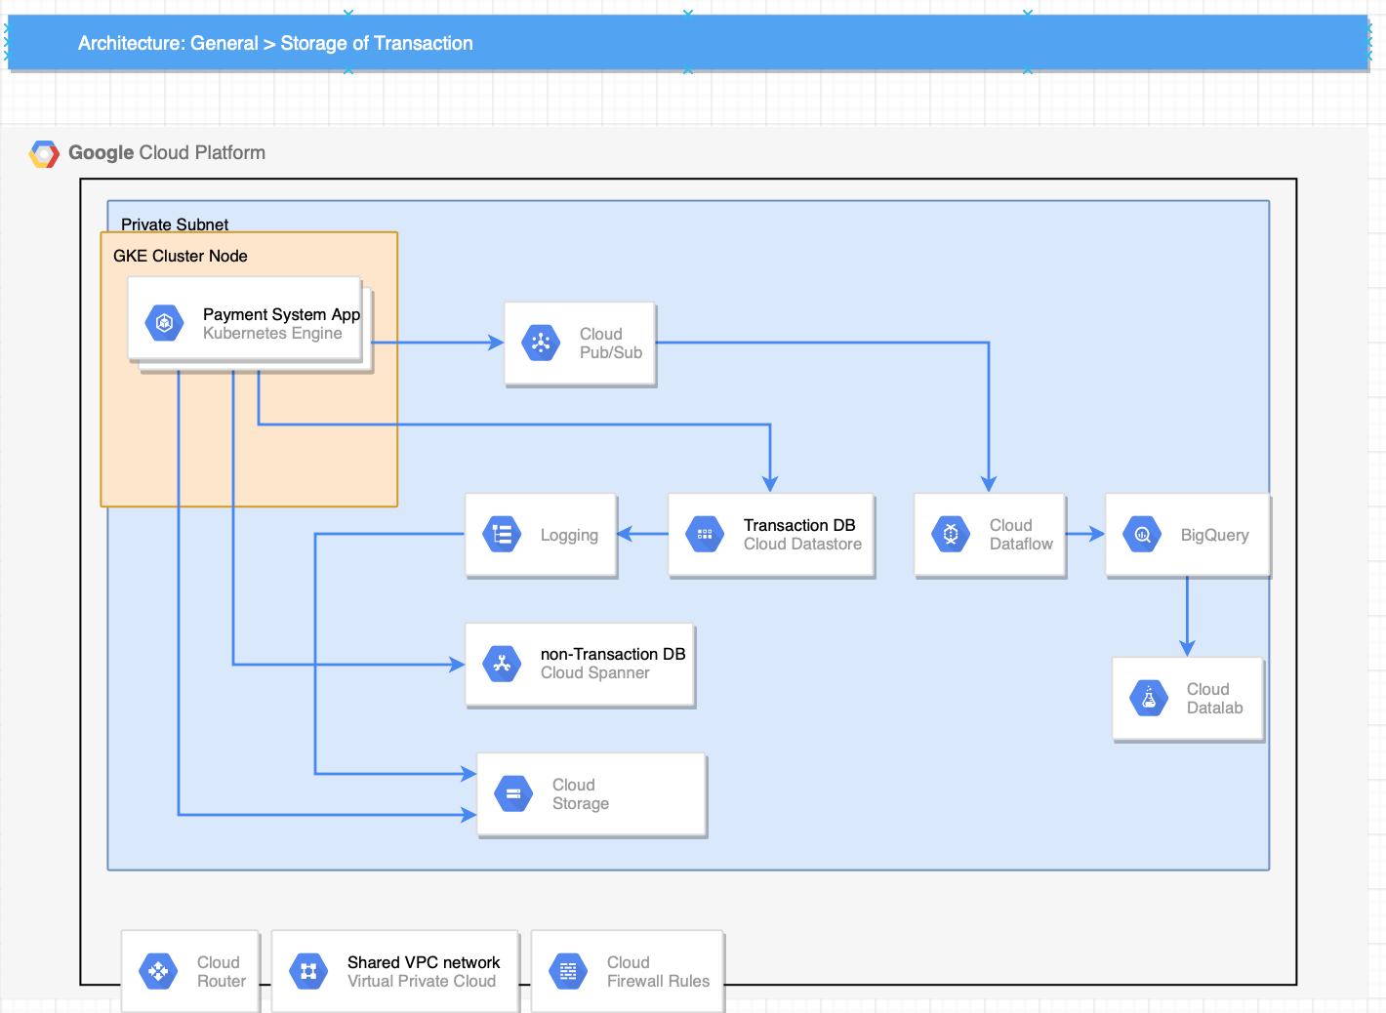
STORAGE INFRASTRUCTURE – TRANSACTION
Decision Points:
Datastore is designed for bank transaction
Pros:
Atomic transactions. Cloud Datastore can execute a set of operations where either all succeed, or none occur.
Balance of strong and eventual consistency.
Encryption at rest.
Fully managed with no planned downtime.
Cons:
Cloud Datastore is not a relational database, and it is not an effective solution for analytic data.
Hence need to use bigquery for data analyse

Slide 7
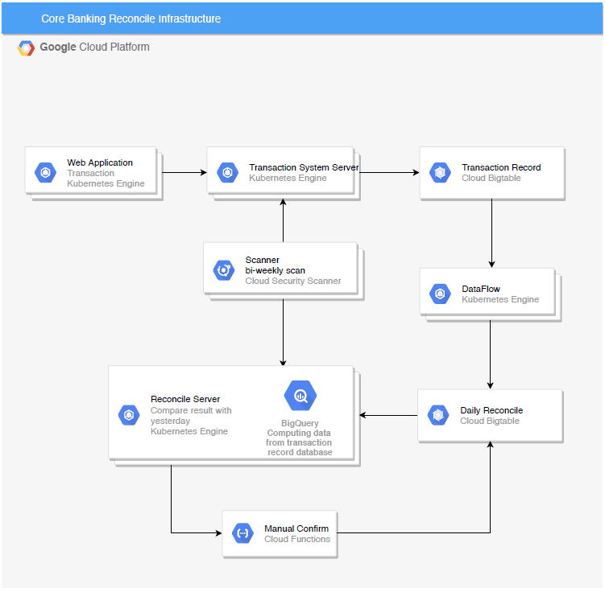
STORAGE INFRASTRUCTURE – RECONCILIATION

Slide 8
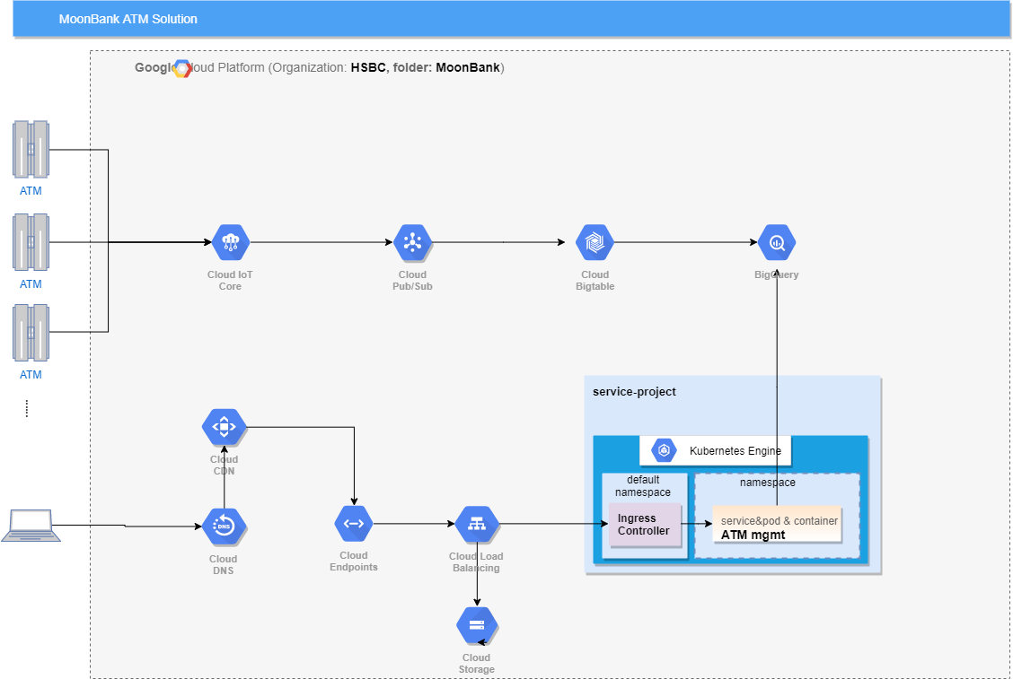
MoonBank ATM ATM/Cash Delivery Solution

